Slide 1
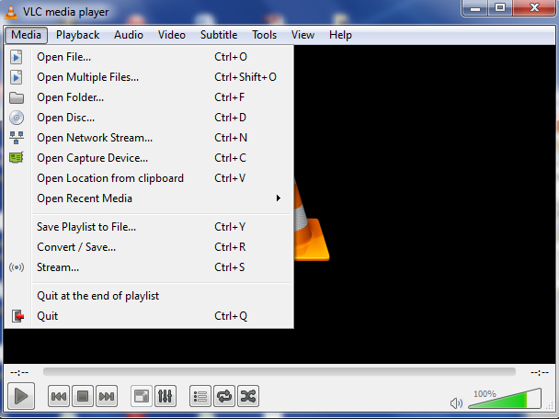
Open your video file. Play the video.
Decide where you want the video to start and stop.
Make note of the start and stop times.

Slide 2
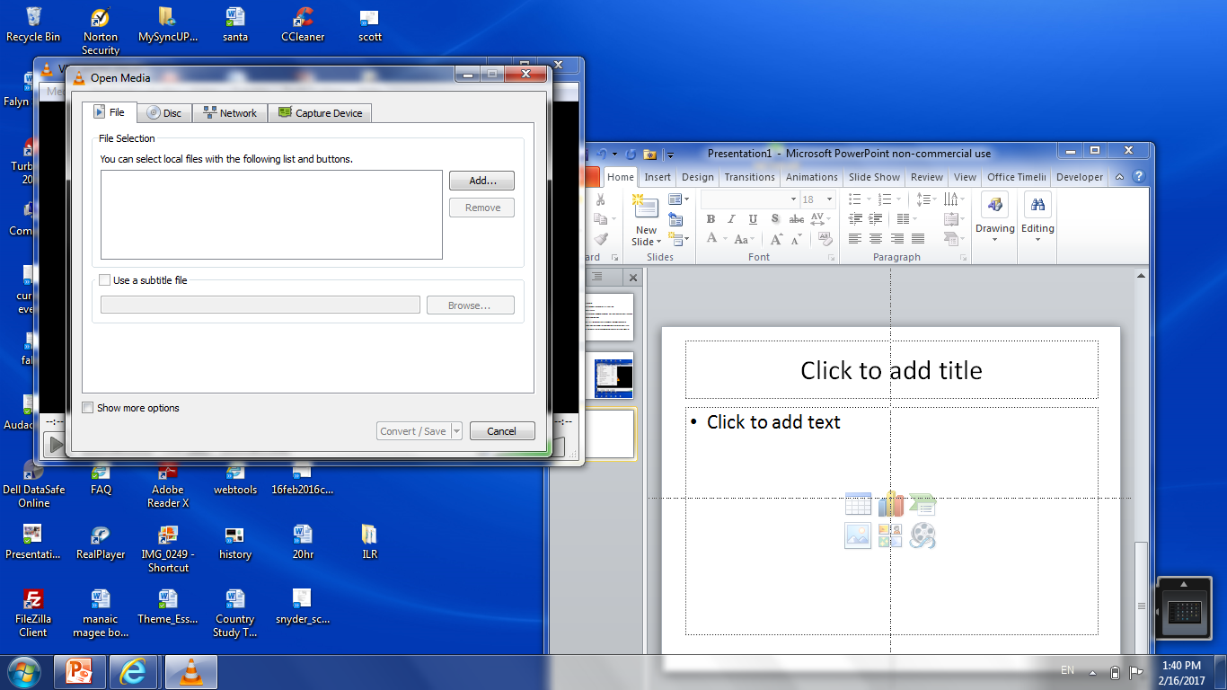
Select Convert/Save
Make sure the video is showing in the box – if not select Add and select the video.

Slide 3
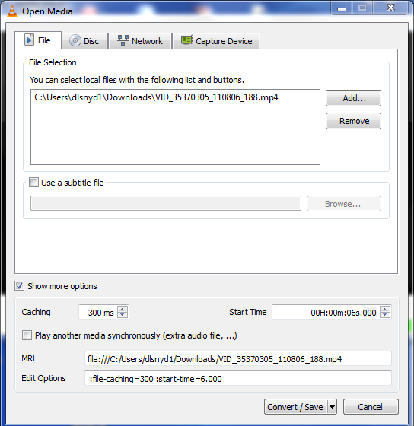
Select the more options box; enter your start and stop times.

Slide 4
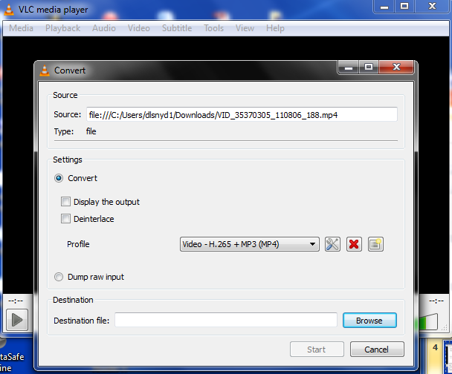
Save the file by selecting the Destination file – name the file and select save.
The file will be converted to the new name in the directory you saved it to.

Slide 5
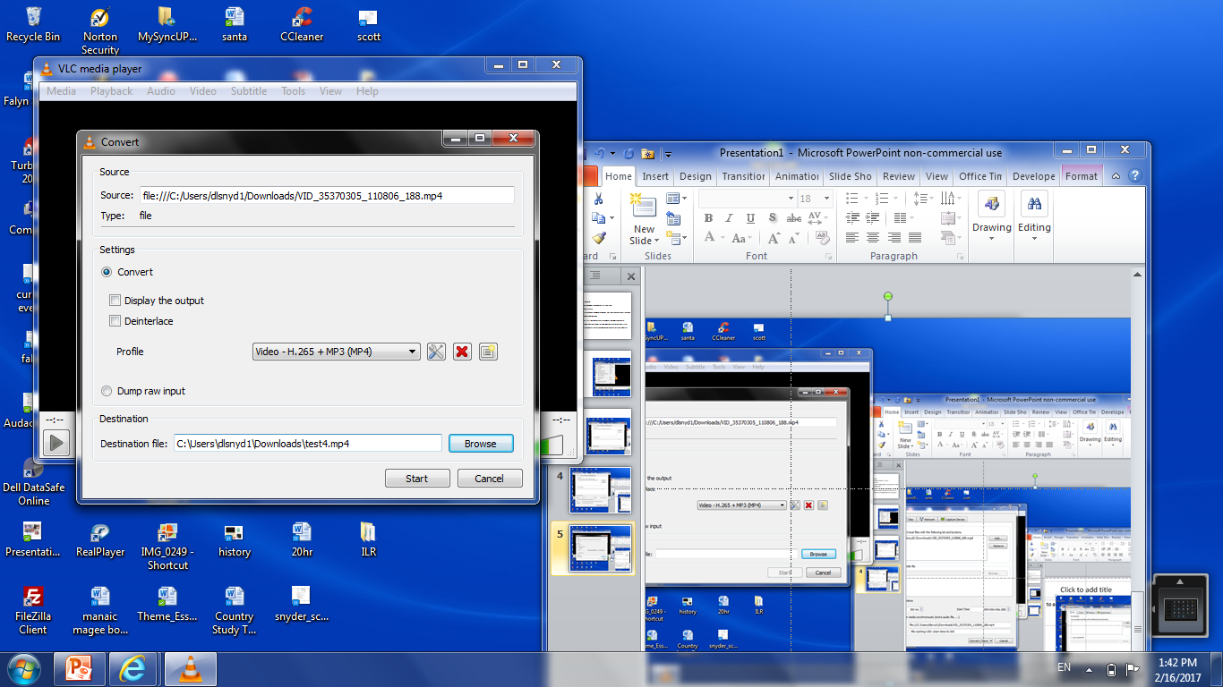

Slide 6
Save the file by selecting the Destination file – name the file and select save.
The file will be converted to the new name in the directory you saved it to.

